Slide 1
Actionscript 3.0 Basics
3 – Display List Api

Slide 2
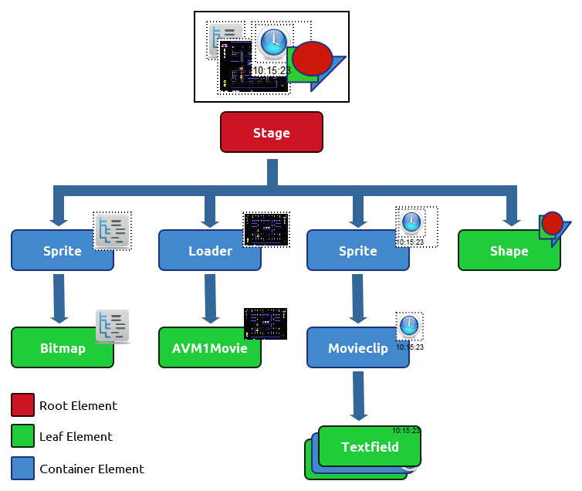

Flash DOM

Slide 3
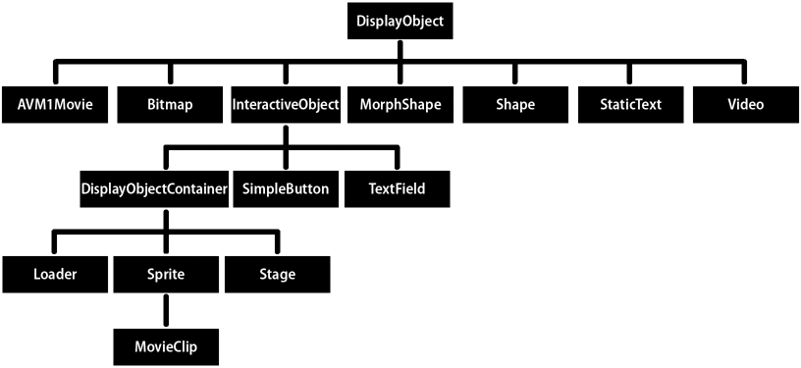
Display Objects

Slide 4
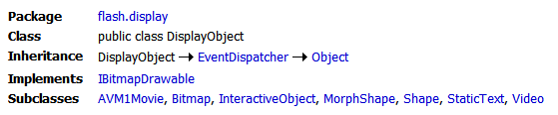
DisplayObject
Is the base class for all objects that can be placed on the display list.
The class itself does not include any APIs for rendering content onscreen.
It is an abstract class, can't be instantiated and is intended to be sub-classed.
Sub-classes of this class will implement rendering mechanisms.
Provides the sizing, positioning, styling, etc. APIs that affect all display objects in flash.

Slide 5
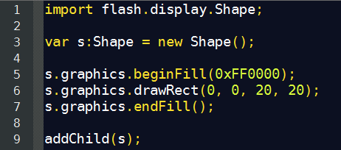
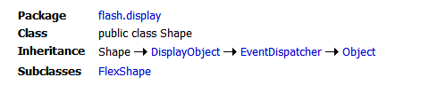
Shape
This class is used to create lightweight shapes using the ActionScript drawing api.
Shape objects consume less memory than Sprite objects.
A Sprite object supports user input events, while a Shape object does not.

Slide 6
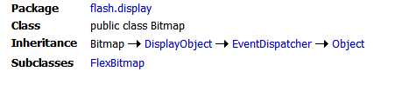
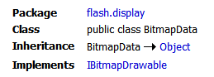
Bitmap (+ BitmapData)
The Bitmap class represents display objects that represent bitmap images.
A Bitmap object can share its BitmapData reference among several Bitmap objects, you can create multiple Bitmap objects that reference the same BitmapData object avoiding the memory overhead of a BitmapData object for each display object instance.
Like Shape, it won't dispatch user iteraction events.

Slide 7
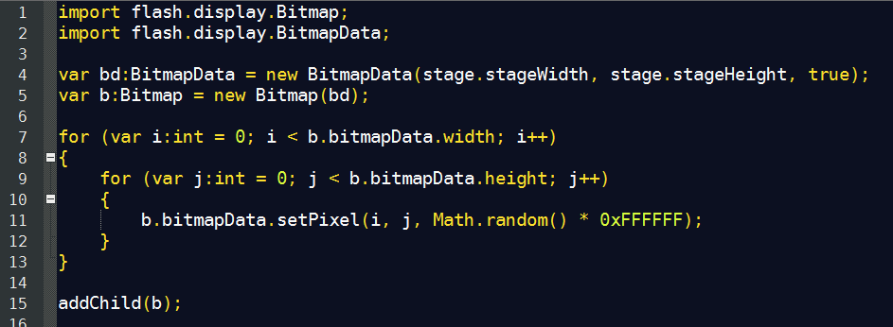
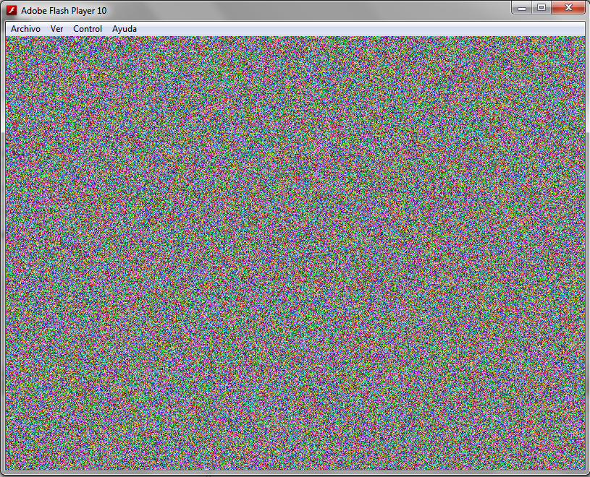
Bitmap (+ BitmapData)

Slide 8
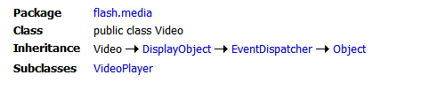
Video
The Video class displays live or recorded video in an application without embedding the video in your SWF file. This class creates a Video object that plays either of the following kinds of video: recorded video files stored on a server or locally, or live video captured by the user. A Video object is a display object on the application's display list and represents the visual space in which the video runs in a user interface.

Slide 9
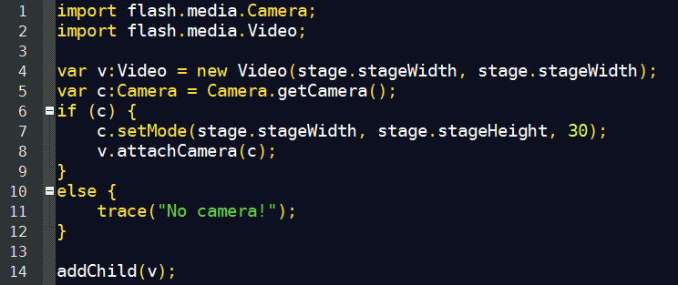
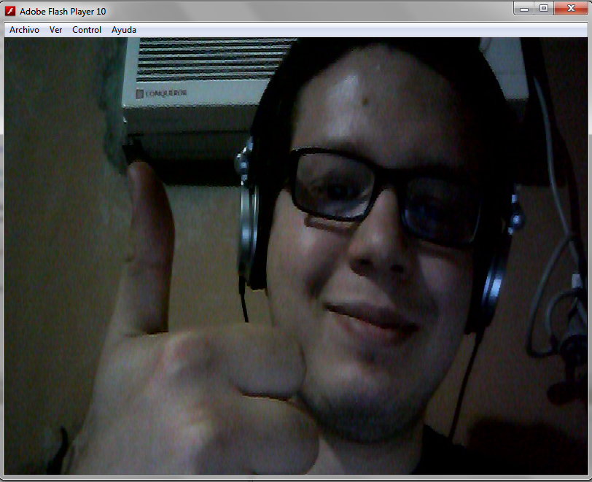
Video

Slide 10
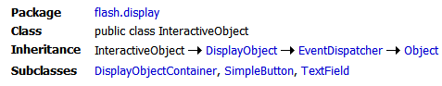
InteractiveObject
The InteractiveObject class is the abstract base class for all display objects with which the user can interact, using the mouse, keyboard, or other user input device.

Slide 11
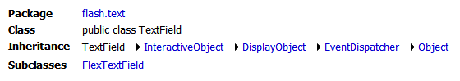
TextField
The TextField class is used to create display objects for text display and input.
The methods of the TextField class let you set, select, and manipulate text in a dynamic or input text field that you create during authoring or at runtime.
ActionScript provides several ways to format your text at runtime. The TextFormat class lets you set character and paragraph formatting for TextField objects. You can apply Cascading Style Sheets (CSS) styles and use some html formatting tags.

Slide 12
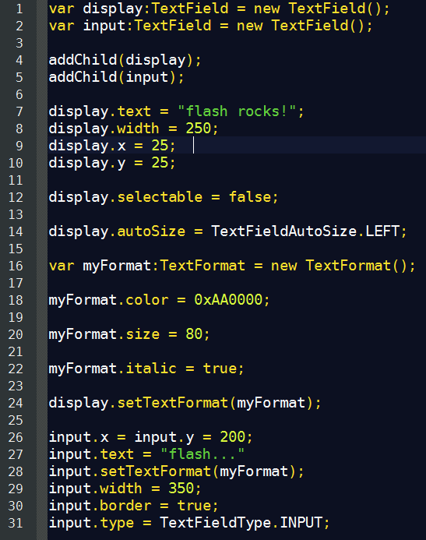
TextField

Slide 13
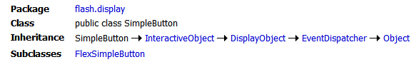
SimpleButton
The SimpleButton class lets you control all instances of button symbols in a SWF file.
Button symbols are ui elements the user can iteract with.
This class makes easy to create buttons in flash.

Slide 14
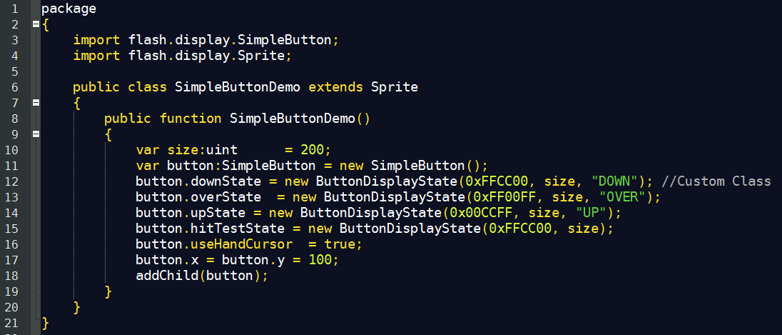
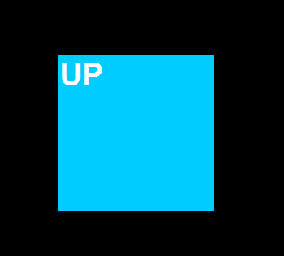
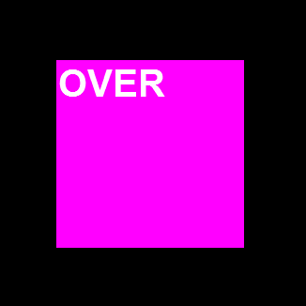
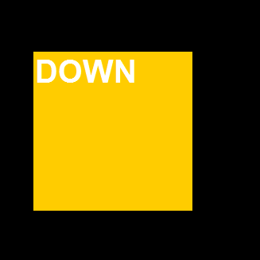
SimpleButton

Slide 15
DisplayObjectContainer
The DisplayObjectContainer class is the base class for all objects that can serve as display object containers on the display list.
Use the DisplayObjectContainer class to arrange the display objects in the display list.
Each DisplayObjectContainer object has its own child list for organizing the z-order of the objects.

Slide 16
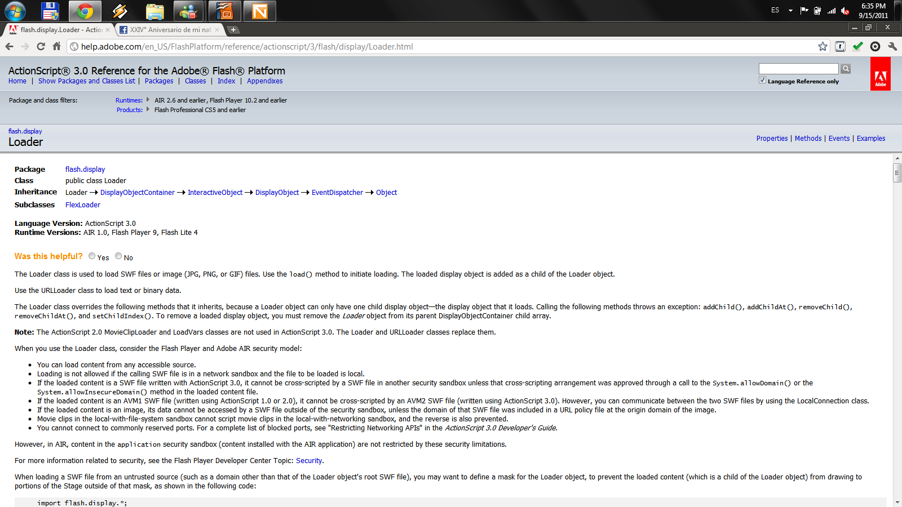
Loader
The Loader class is used to load SWF files or image (JPG, PNG, or GIF) files. Use the load() method to initiate loading. The loaded display object is added as a child of the Loader object.

Slide 17
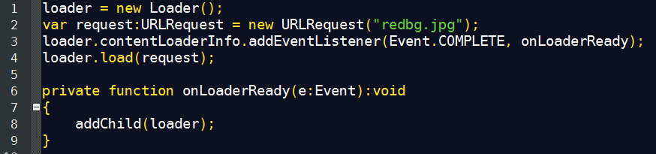
Loader

Slide 18
Thanks!
github.com/matix/as3basics
matias.figueroa@globant.com
@matixfigueroa

